Slide 1
MICRO – CREDIT DEFAULTER PROJECT
Machine learning model
Prepare By
Rajashri Sadafule Darveshi

Slide 2
Problem Statement
Problem Statement:
A Microfinance Institution (MFI) is an organization that offers financial services to low income populations. MFS becomes very useful when targeting especially the unbanked poor families living in remote areas with not much sources of income. The Microfinance services (MFS) provided by MFI are Group Loans, Agricultural Loans, Individual Business Loans and so on.
Many microfinance institutions (MFI), experts and donors are supporting the idea of using mobile financial services (MFS) which they feel are more convenient and efficient, and cost saving, than the traditional high-touch model used since long for the purpose of delivering microfinance services. Though, the MFI industry is primarily focusing on low income families and are very useful in such areas, the implementation of MFS has been uneven with both significant challenges and successes.
Today, microfinance is widely accepted as a poverty-reduction tool, representing $70 billion in outstanding loans and a global outreach of 200 million clients.
We are working with one such client that is in Telecom Industry. They are a fixed wireless telecommunications network provider. They have launched various products and have developed its business and organization based on the budget operator model, offering better products at Lower Prices to all value conscious customers through a strategy of disruptive innovation that focuses on the subscriber.

Slide 3
Problem statement
Problem Statement:
They understand the importance of communication and how it affects a person’s life, thus, focusing on providing their services and products to low income families and poor customers that can help them in the need of hour.
They are collaborating with an MFI to provide micro-credit on mobile balances to be paid back in 5 days. The Consumer is believed to be defaulter if he deviates from the path of paying back the loaned amount within the time duration of 5 days. For the loan amount of 5 (in Indonesian Rupiah), payback amount should be 6 (in Indonesian Rupiah), while, for the loan amount of 10 (in Indonesian Rupiah), the payback amount should be 12 (in Indonesian Rupiah).
The sample data is provided to us from our client database. It is hereby given to you for this exercise. In order to improve the selection of customers for the credit, the client wants some predictions that could help them in further investment and improvement in selection of customers.

Slide 4
Understanding of problem statement
A Micro Finance Institute (MFI) is an financial organization who focus and target the unbaked low income population, living in remote areas who does not have much source of income. They have global outreach of 200 million clients with $70 billion as an outstanding loans that is why these micro finance institutes are widely accepted as poverty reduction tools.
These MFIs have understood the importance of communication in a person’s daily life & how it affects the life of person hence to improve the basic need of communication of financially poor low income families living in remote areas they come up with a concept of providing mobile balance credits to the people, collaborating with a Telecom industry who provides wireless telecommunication network & are good with providing better offer at low price.
Now there is a challenge of default case where a user don’t pay back the loaned mobile balance back. To encounter this problem organization wants a machine learning model that can predict the default case so that they can prevent their financial loss & can improve their services.

Slide 5
Understanding the data
The micro credit defaulter data is of a telecom industry, describing the recharges of customer mobile balance, average balance of 30 day & 90 days, average spent of balance in 30 days & 90 days, loan opted by customer in 30 days & 90 days, circle of telecom, mobile number etc.
The data consist of 36 such columns and had record of over 2 lack customers.
Data has no missing values.
This data has originated from the client data base.
The format of data was in csv format.
The data had 3 categorical column & out 2 columns were object data type.
Rest all of the columns were continuous data having integer or float data type.

Slide 6
Software, tools & Libraries used in project
Python Programming language in Jupyter NoteBook is used for this project.
Anaconda software provided all of the above-mentioned thing in one platform.
Pandas Library is used to read the data in python programming language.
Numpy Library is used for mathematical implementation in the dataset.
Matplotlib & Seaborn libraries used for plotting and visualizing the statistical analysis of the data
Scikit Learn is used for model building, model evaluation & Hyper parameter tuning of the model.
Pickle used to save the model in local system.

Slide 7
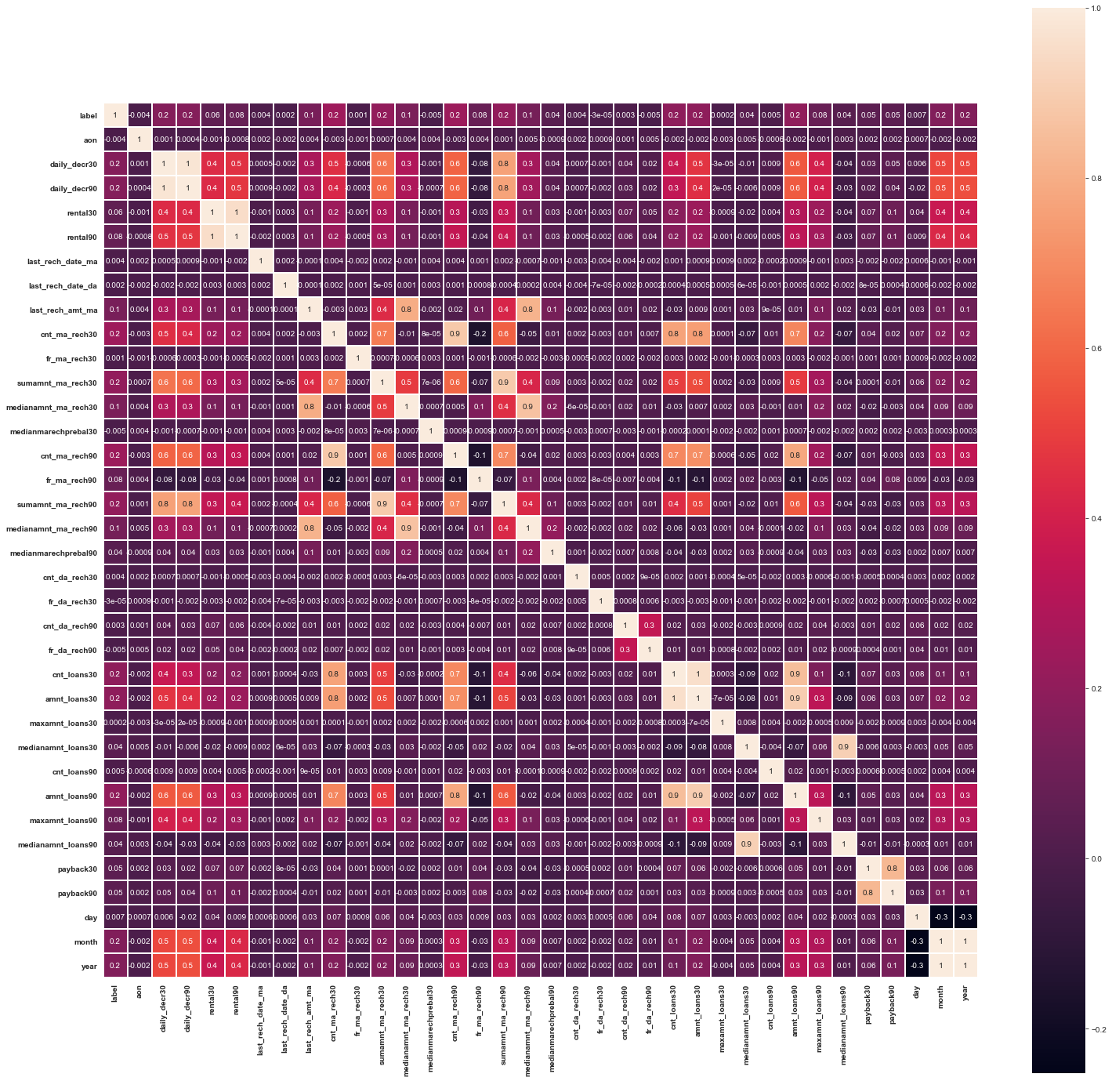
Heat Map
From the heat map we found that relation of all the features column with target column are not much high, maximum it is going upto 0.2. But we can see some of lightcolor highlighted square in the heatmap which is showing relations of feature column with another feature column, & light color is showing some high relations between them, which is greater than 0.4 is most of the cases. So here we can interpret that some of pairs of columns are highly related with each other.

Slide 8
Exploratory data analysis & Understanding of visualization
For the exploratory data analysis and visualization of the data we used matplotlib library’s pyplot package & seaborn library.
For the understanding of categorical data we used count plot.
For the continuous data we used distribution plot.
We used box plot to see & understand the outliers in the data set.
For the correlation of the data we used heat map of seaborn.
We also used scikit’s roc plot to visualize the area under the curve to evaluate the machine learning models.
Based on these steps of eda & visualization we took some assumption & processed necessary steps to complete this project which we are going to discuss in this power point presentation.

Slide 9
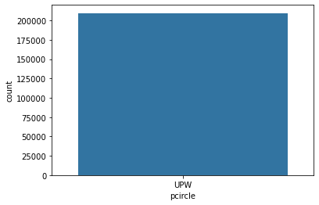
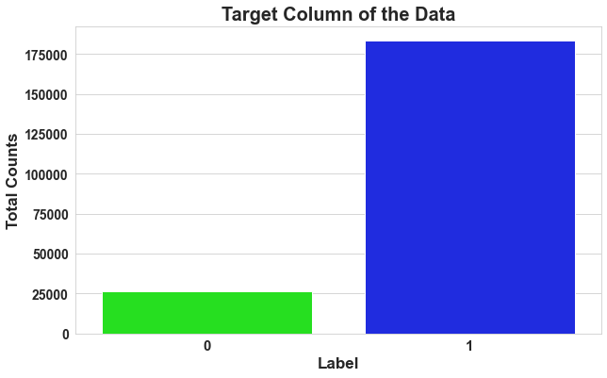
EDA & visualization of categorical data & conclusion.
From the data description of micro credit data we got to know that Label column is our class or target column representing default and not default cases.
Where 0 was or default case & 1 was for not default case.
From the data visualization we analyzed that class data is imbalanced data.
Hence we concluded to balance the data by over sampling of class data
We found in pcircle column only 1 category is present named upw.
From this we concluded that this column is neutral for each row & will play no role in defaulter prediction.
Hence we decided to drop this column.

Slide 10
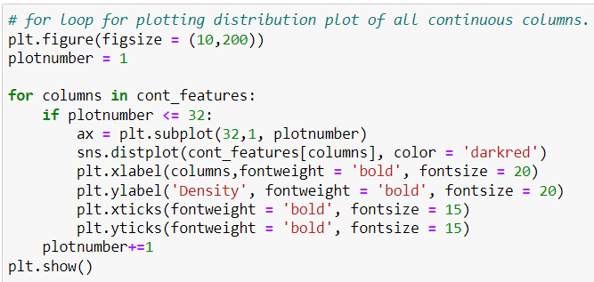
Code for visualization distribution plot continuous column

Slide 11
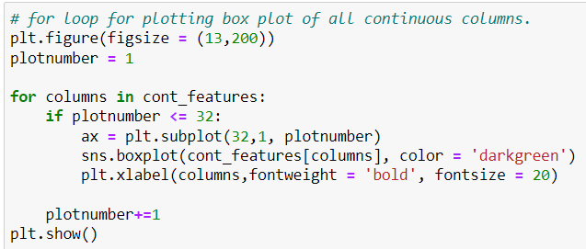
Code for visualization box plot of all the continuous column

Slide 12
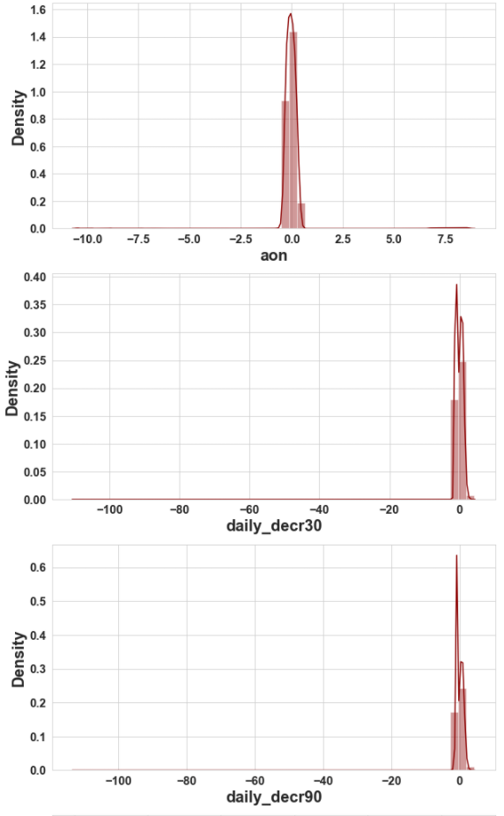
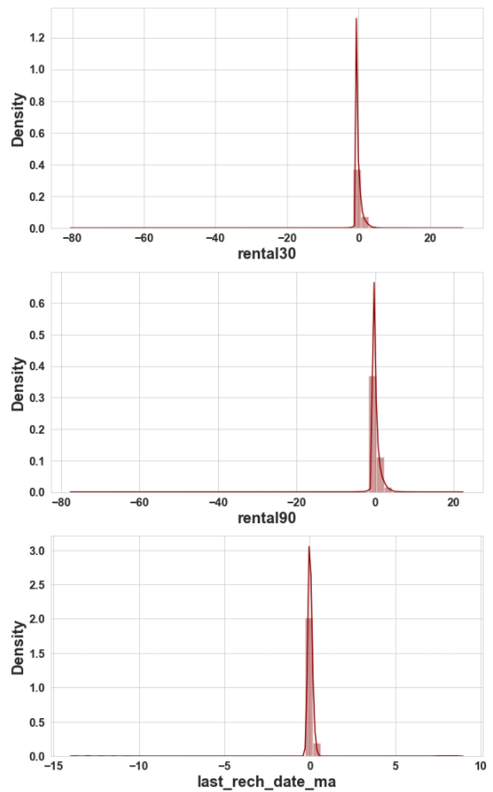
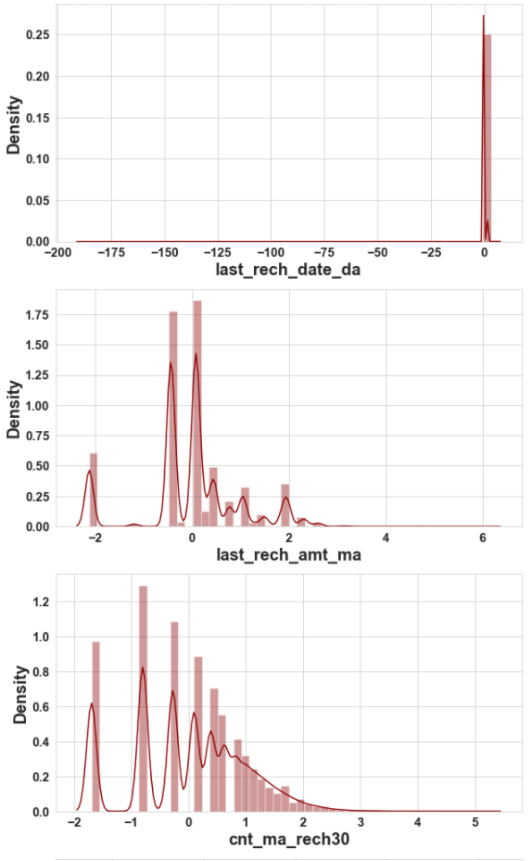
Visualization of count plot

Slide 13
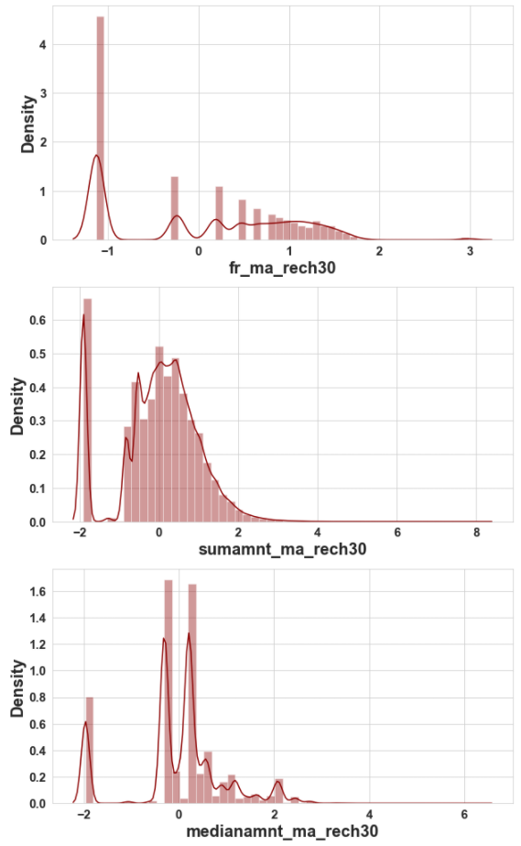
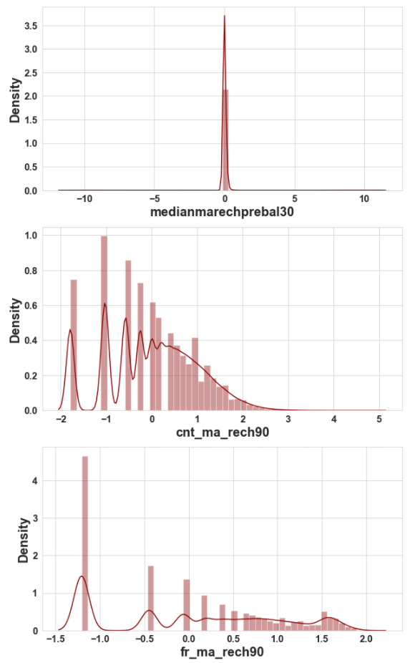
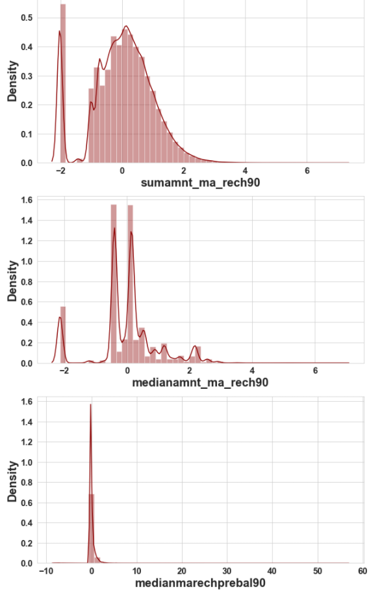
Visualization of count plot

Slide 14
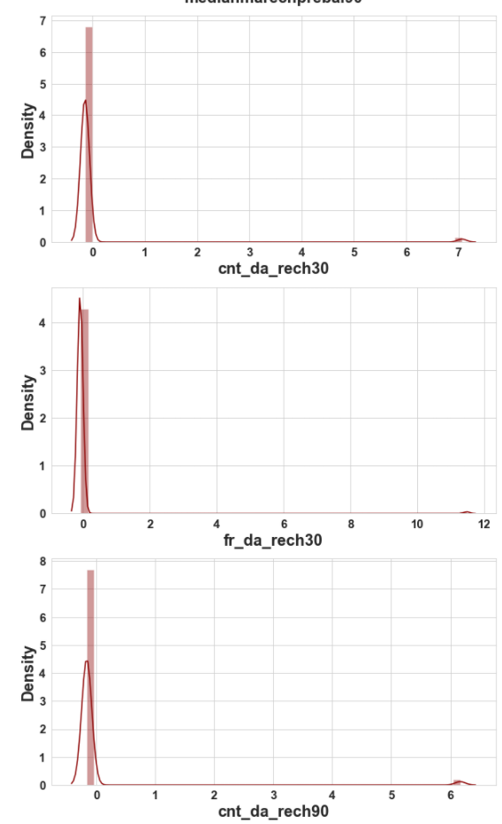
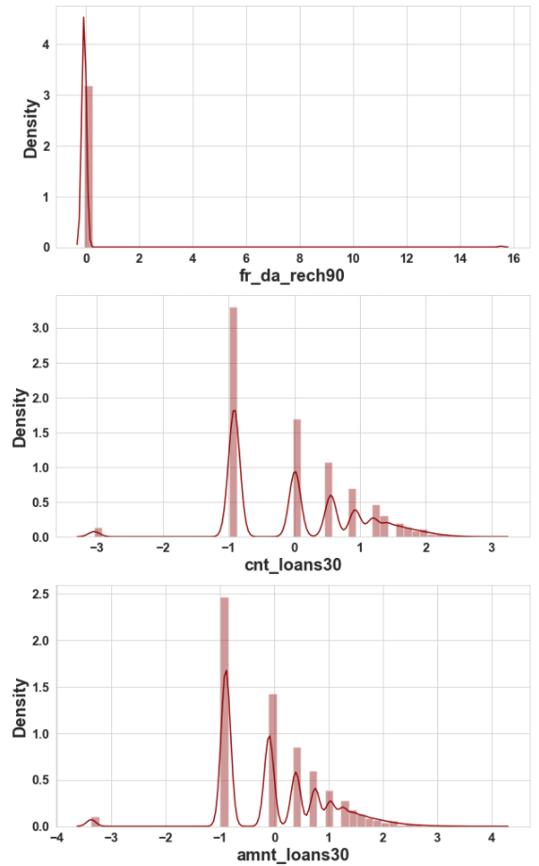
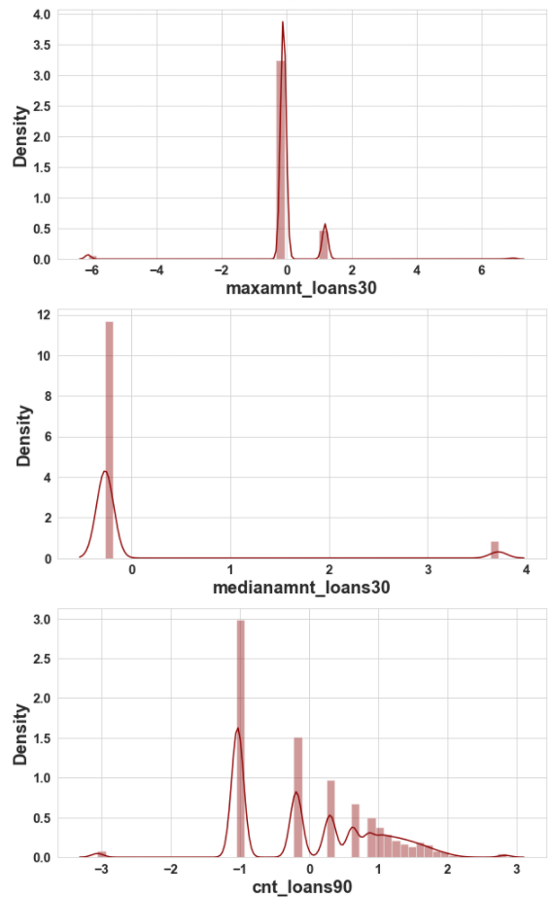
Visualization of count plot

Slide 15
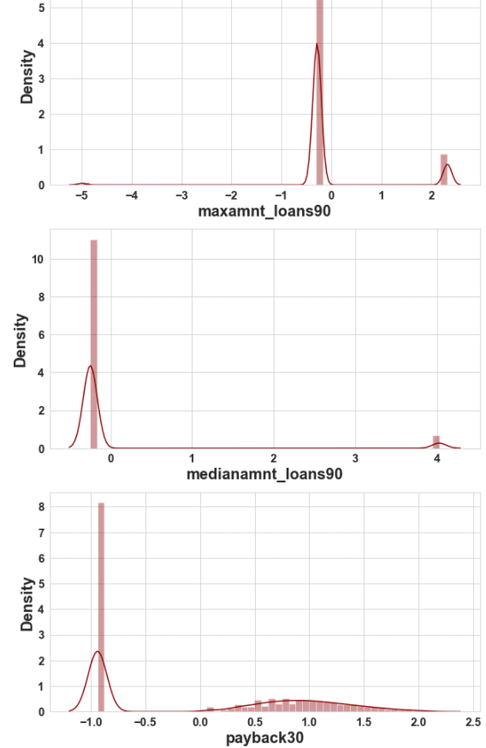
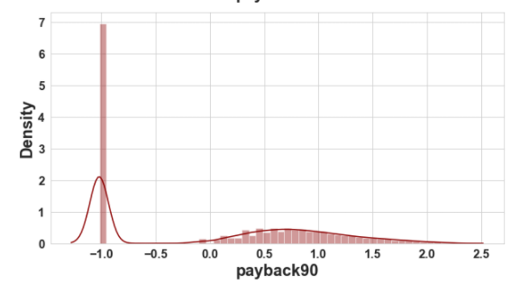
Visualization of count plot

Slide 16
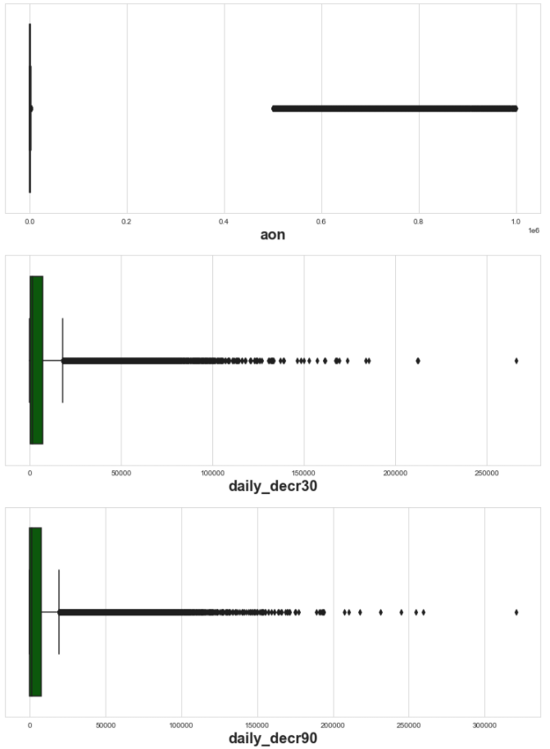
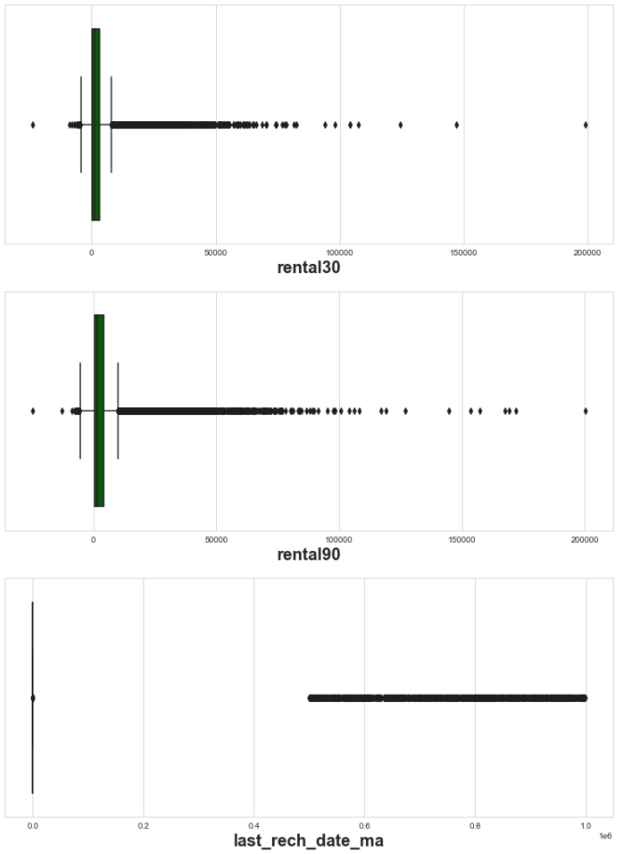
Visualization of Box plot

Slide 17
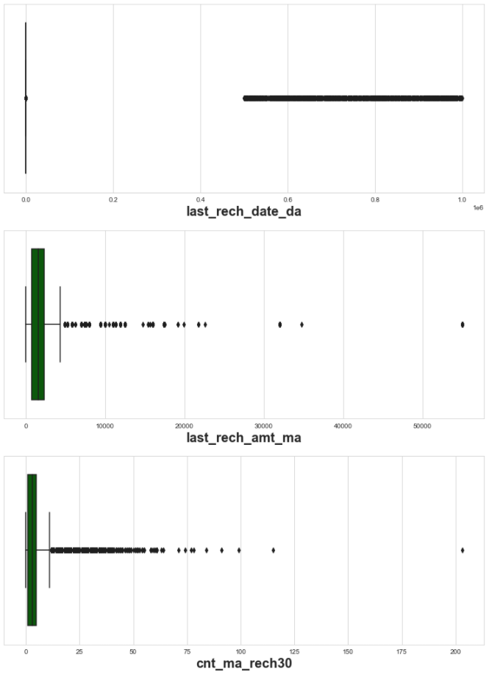
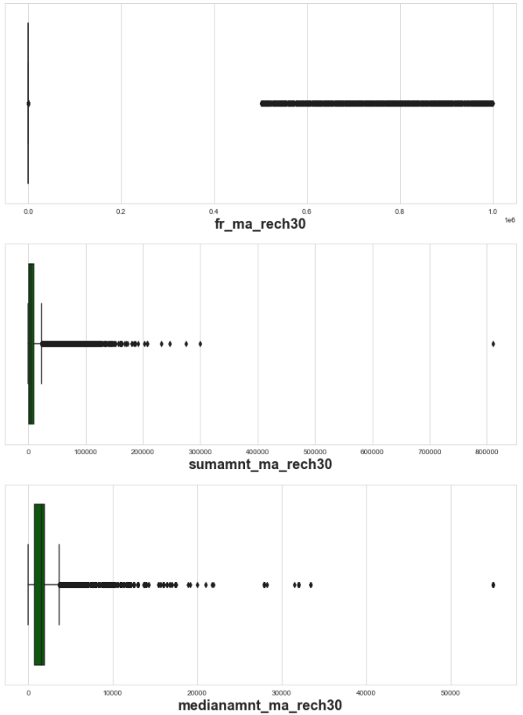
Visualization of Box plot

Slide 18
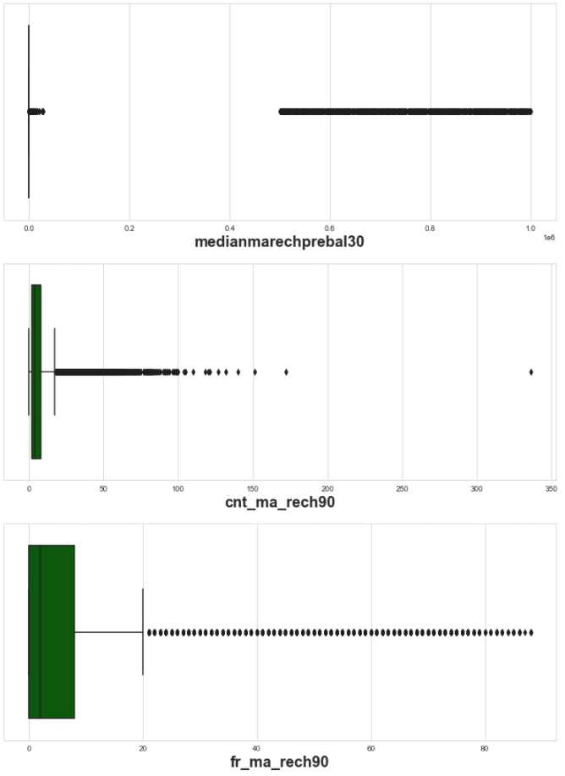
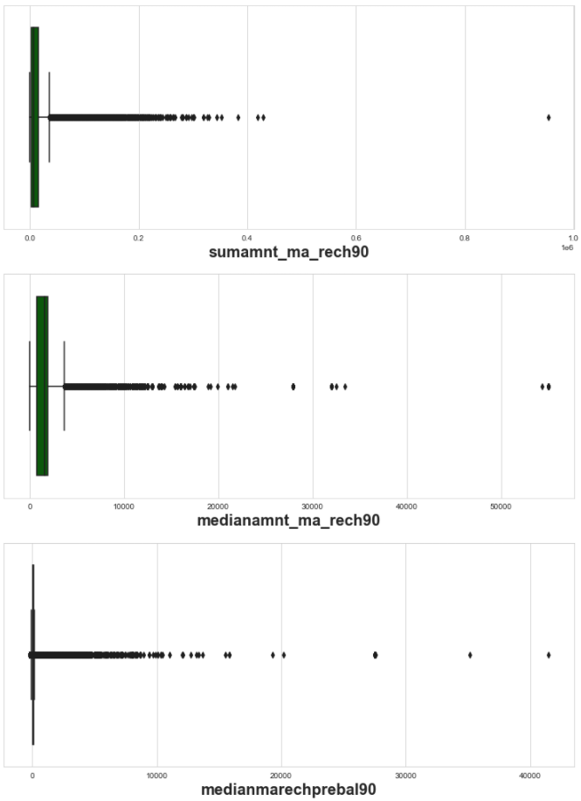
Visualization of Box plot

Slide 19
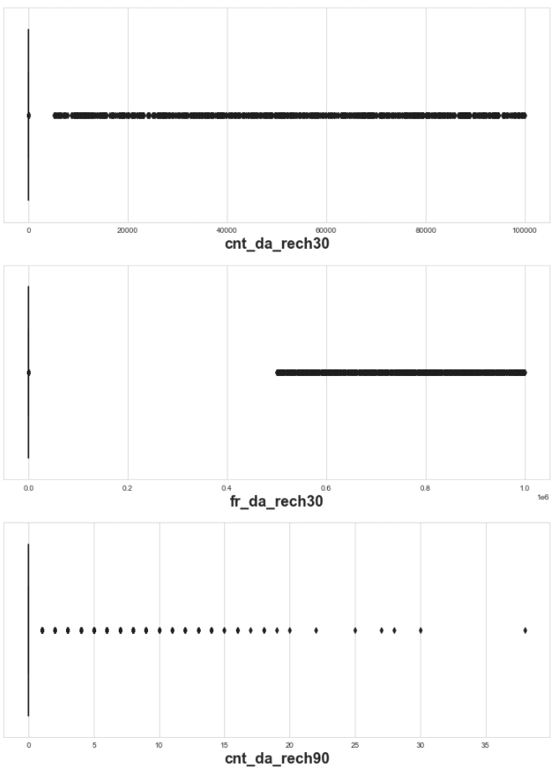
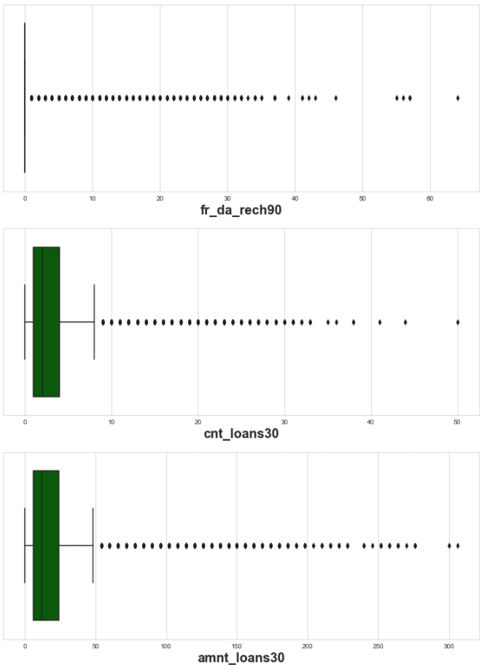
Visualization of Box plot

Slide 20
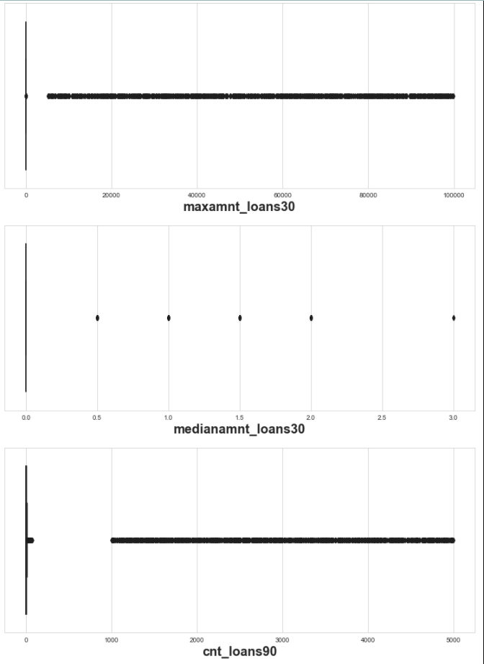
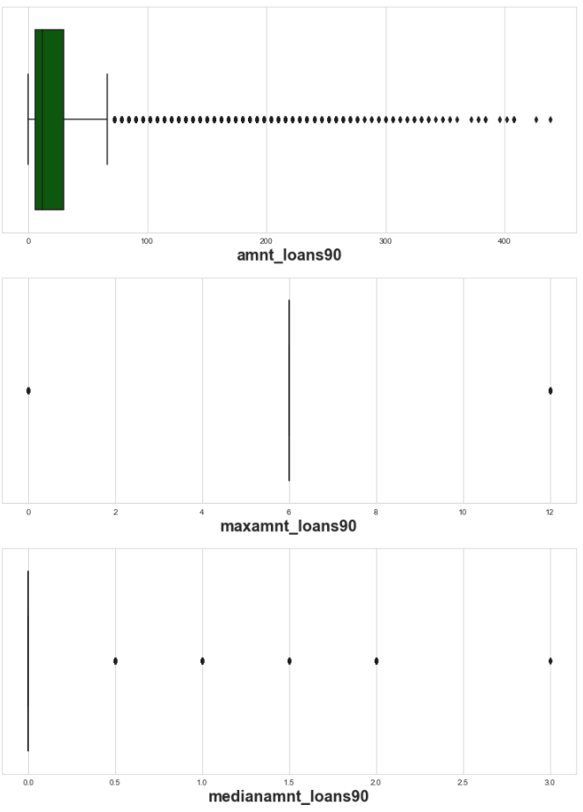
Visualization of Box plot

Slide 21
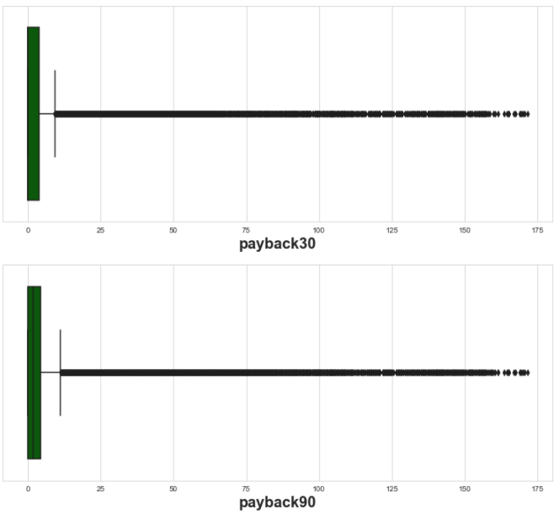
Visualization of Box plot

Slide 22
Findings, assumptions, conclusions & data analysis
After doing the research on data analysis we found that data was messed up too much, before visualizing we have seen the statistical description of the continuous columns and found that in almost each case standard deviation was greater than the mean of the data the reason for this was because in each case up to 90% data was distributed on either a single point or in a definite range but 10% data was far ahead than them. Box visualization shows us that the amount of the outliers are very much, we can’t afford to loose this much data hence we applied power transformation (yeo-Johnson) method to remove the skewness. It did well in most of the cases but not in all the cases. Because we have transformed the data through power transformation we move ahead in the process of model building. After this we did some preprocessing of the data, we scaled the data, found the best random state for train test & split, than we split the data into train data & test data. After preprocessing we started building the model.

Slide 23
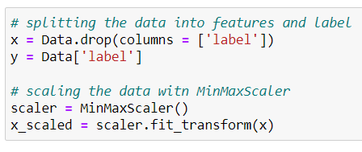
Data scaling code & documentation.

Slide 24
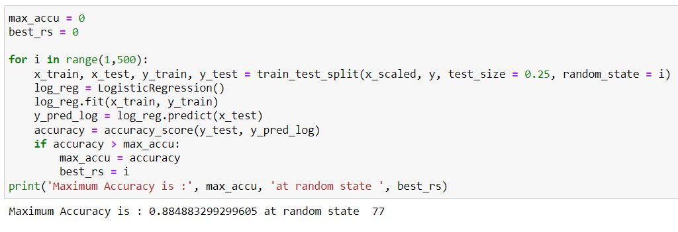
Finding of best random state for train & test data.

Slide 25
Machine learning model building
After doing the preprocessing like data scaling, splitting the data into train data & test data and finding the best random state we started doing machine learning model building with the help of scikit learn library. We have chosen to build 5 models for the project.
Logistic Regression.
K-Nearest Neighbors.
Decision Tree.
Random Forest.
Support Vector Machine.

Slide 26
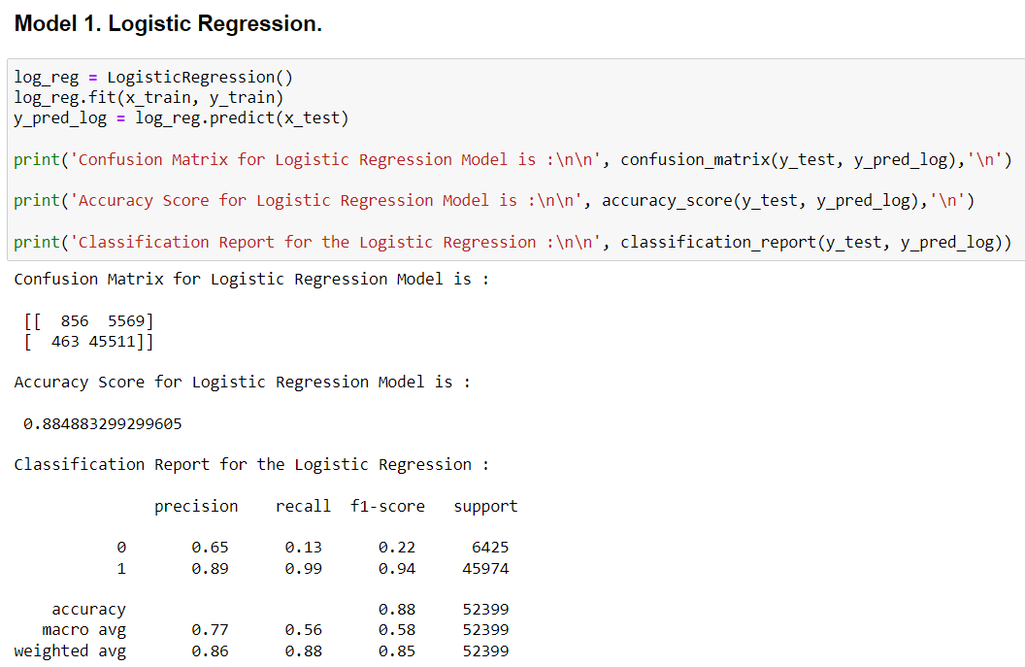
Model 1. Logistic Regression

Slide 27
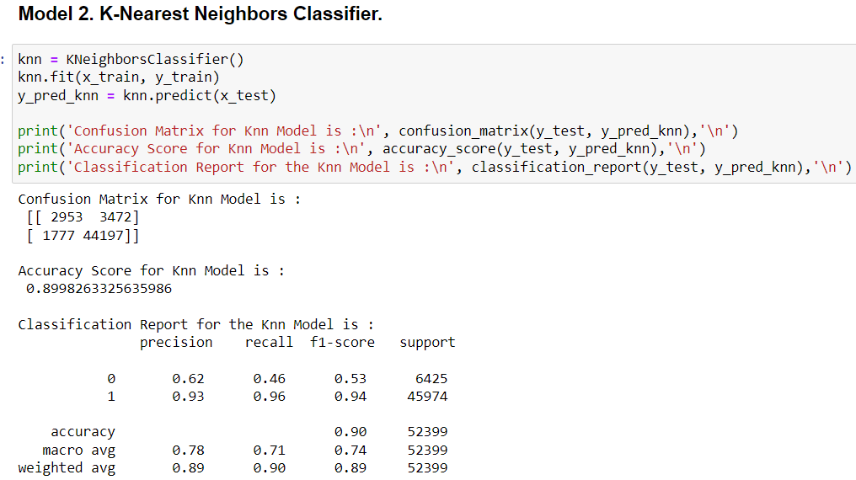
Model 2. K-Nearest Neighbors Classifier

Slide 28
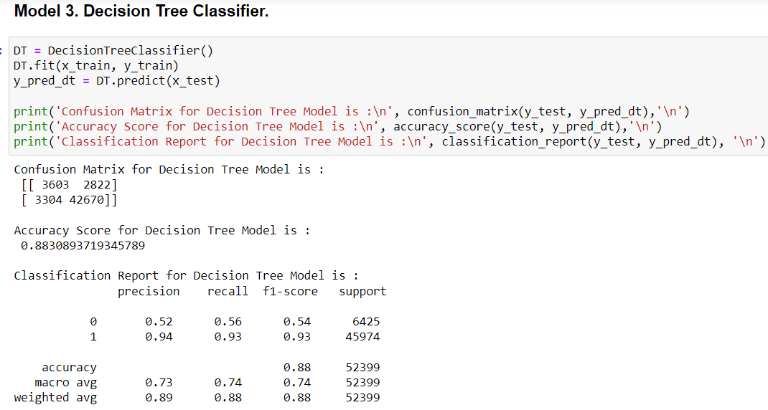
Model 3. Decision Tree Classifier

Slide 29
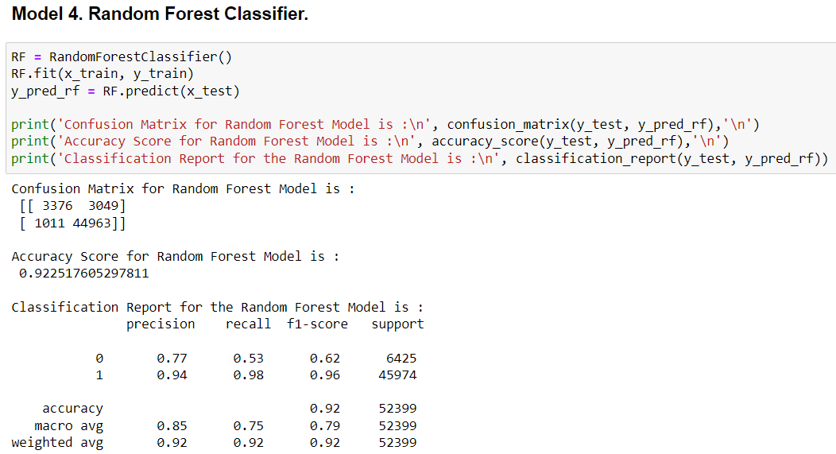
Model 4. Random Forest Classifier.

Slide 30
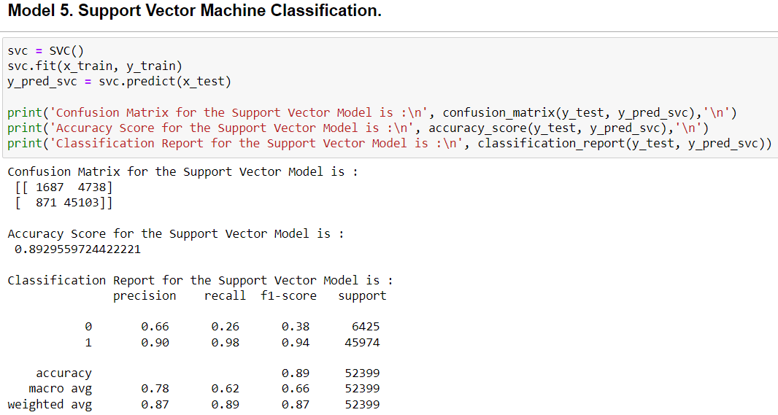
Model 5. Support Vector Machine Classification.

Slide 31
Conclusions of machine learning models.
We build 5 supervised machine learning classification models as we discussed above.
We got very good accuracy score in all 5 models, the least score was of decision tree model (88.3%) & the maximum score was of Random Forest(92.25).
But we had very poor precision, recall & f1 score on every model except random forest. Random Forest model had good precision(0.77), recall(0.53) & f1 score(0.63).
After model building we had to make sure if our models are over fitted or under fitted or not, so we validated it with cross validation with the help of scikit learn’s model selection package.

Slide 32
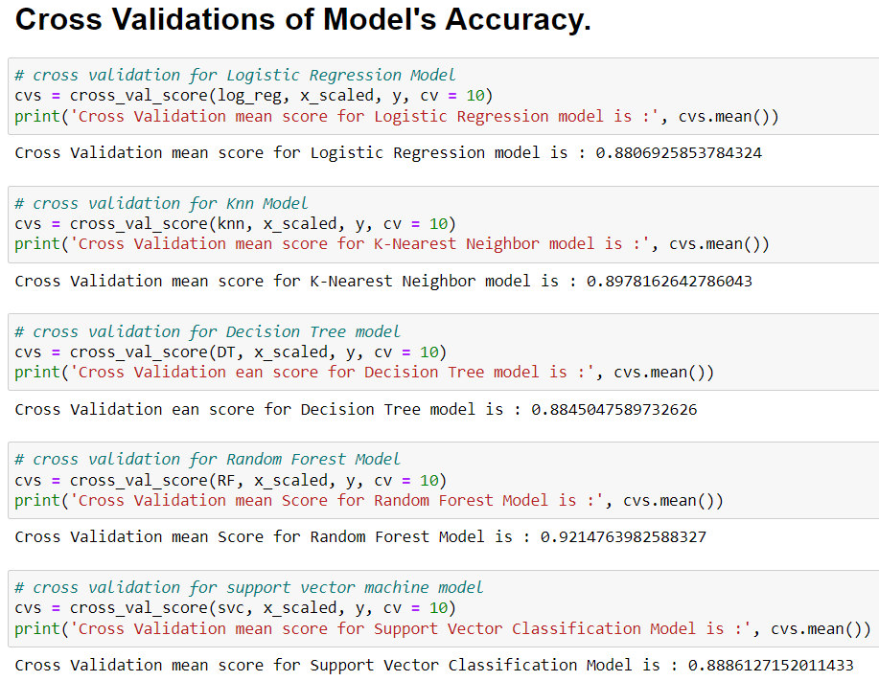
Cross validation code & result.

Slide 33
Result of cross validation
After cross validation of the model we found that the result of cross validation score are almost same what we had in default models, they had only very few difference as you can see in the table.
We had decision tree model whose cross validation was even greater than the default model.
From this step we concluded that our models are neither over fitted nor under fitted.
But from this we got confused as which model we should choose as best model because as per minimum difference between default accuracy score & cross validation score we had decision tree model. But on the other hand decision tree had least accuracy score among all models & also precision, recall & f1 score was not so good.
So we decided to evaluate the model with the help of roc_auc plot so that we can choose the model who has highest area under the curve.
Models | Model Accuracy | Cross Validation Score | Difference
Logistic Regression | 88.49 | 88.06 | 0.43
K-Nearest Neighbors | 89.98 | 89.78 | 0.2
Decision Tree | 88.34 | 88.45 | -0.11
Random Forest | 92.28 | 92.14 | 0.14
Support Vector Machine | 89.29 | 88.86 | 0.43

Slide 34
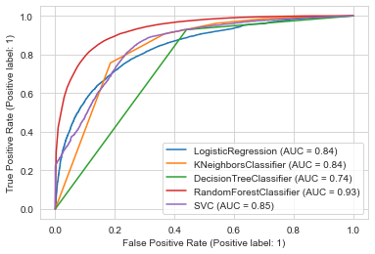
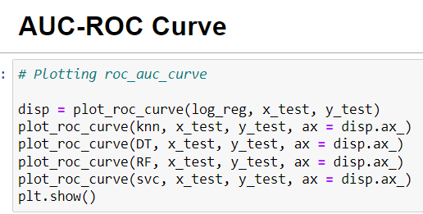
Roc-Auc curve plotting code & documentation.

Slide 35
Roc - Auc plot result & conclusion.
After plotting roc_auc plot, we were clear about our best model to choose we got the Random Forest model having highest area under the curve.
Random Forest model was the model which had highest accuracy score, precision, recall & f1 score and this model had even the highest area under the curve.
Hence we selected Random forest as our project’s model for defaulter prediction & now we wanted to do some hyper parameter tuning in the model so that we could get more accuracy if possible, hence we did the same.

Slide 36
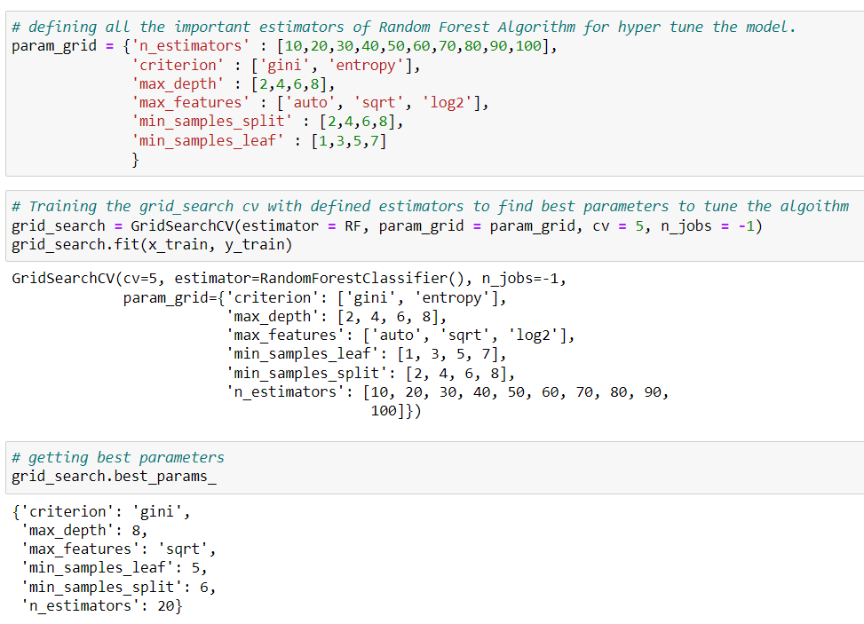
Hyper parameter code & best parameters

Slide 37
Hyper parameter tuning result & conclusion
Hyper parameter tuning of Random Forest algorithm was the most challenging part of the project.
The data set was huge, and we were aware that if we give large parameters to GridSearchCV for Random Forest it would take a lot of time, but we were not aware that it would take more than 48 hours to train.
We tried to train the GridSearchCV on Google colab there also it failed multiple times, hence we reduced the parameters and tried again.
Even after giving 48 hours to the hyper tuning the result was not satisfying, it gave us score lower than what we had with default parameters.
Hence proceeded the model saving with default Random Forest model.

Slide 38
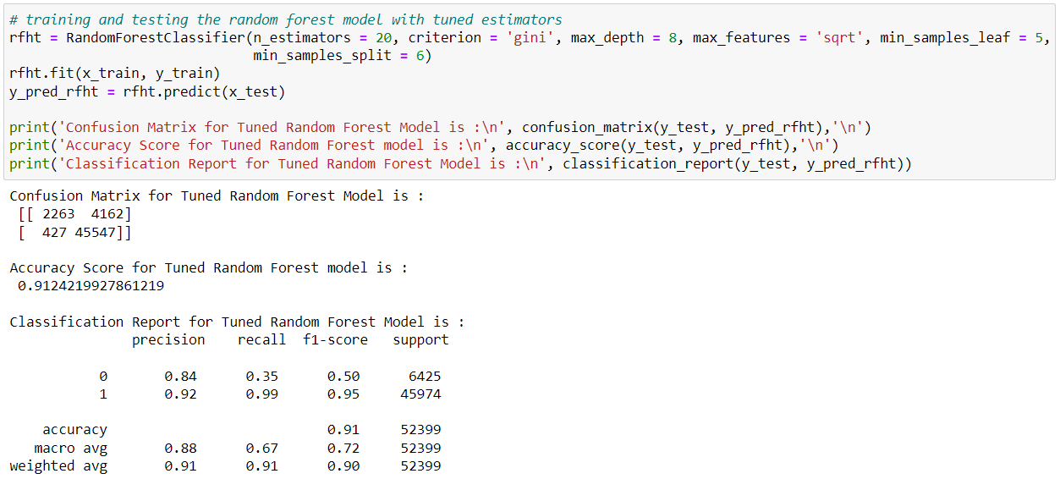
Training & testing of Random forest with tuned parameters.

Slide 39
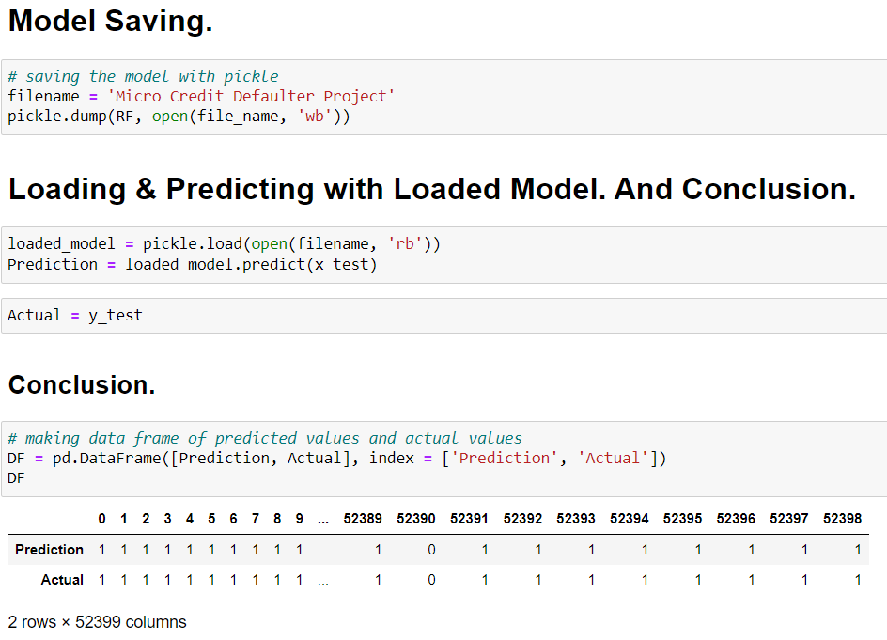
Final step of project model saving, predicting with loaded model & comparing with actual data

Slide 40
Model saving & conclusion.
At the last step of the project we decided to go with the Random Forest model with default parameters.
We saved the model in the local system with the help of PICKLE.
After saving the model we tested it by loading the model & predicting the test data with loaded model.
After prediction of test data with loaded model we made a Data Frame of actual outcomes and predicted outcomes with loaded model and concluded that.

Slide 41
Thank You

